Slide 1


Unit 2.2
Consumer Perspectives in Marketing Ethics
Professor Deirdre Shaw

Slide 2

Aims
Examine the attitude-behaviour gap
Explore issues impacting ethical consumer choice
Highlight some key drivers in ethical consumer decision-making
Examine the link between theory and practical application
  Theory of Planned Behaviour
  Bounded Rationality
  Care in Consumption
  Neutralisation
  Consumer Sovereignty – boycott, buycott, consumption as voting

Slide 3
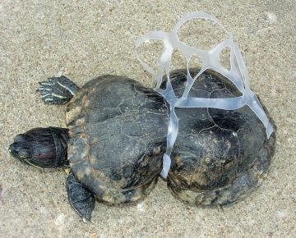
To reverse the accelerating impacts of market failures requires significant and permanent behavioral changes at micro and macro levels

Slide 4
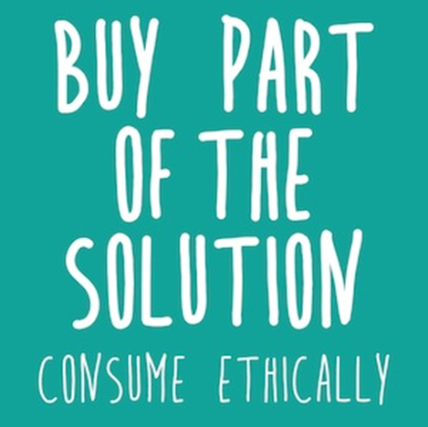
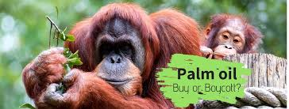


Who’s behaviour must change?

Slide 5

Ethical Consumption ‘Gap’
Do consumers really care about corporate responsibility? Highlighting the attitude-behaviour gap
Practice what you preach!?
How can environmental information align consumer behaviour with attitude?
Saying one thing and doing another
Why green consumers continue to fly
Minimizing the young consumers’ attitude-behaviour gap in green purchasing
Why people don’t take their concerns about fair trade to the supermarket
Why ethical consumers don’t walk the talk
Care and commitment in ethical consumption: An exploration of the attitude-behaviour gap
The ideology of the ethical consumption gap…

Slide 6

Social desirability bias

Slide 7
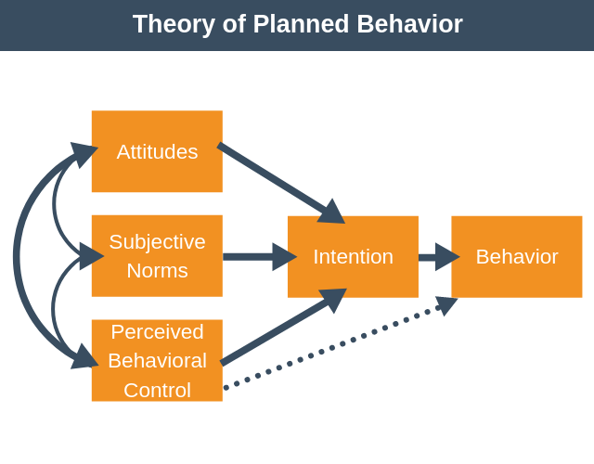

Slide 8
TRA/TPB Additions/Modifications
Ethical/moral obligation (e.g., McEachern et al., 2007; Ozcaglar-Toulouse et al., 2006; Shaw and Shiu, 2003; Sparks et al., 1995)
Self-identity (e.g., Bartels and Hoogendam, 2011; Cook et al., 2002; Fielding et al., 2008)
Information (e.g., Bergin-Seers and Mair, 2009; Pelsmacker and Janssens, 2007)
Willingness to pay (e.g, Ha-Brookshire and Norum, 2011)
Involvement (e.g., Barber et al., 2010; Vermeir and Verbeke, 2006)
Emotion (e.g., Moons and De Pelsmacker, 2012; Spence and Townsend, 2006)
Knowledge (e.g., Annunziata et al., 2011; Dahm et al., 2009; De Pelsmacker et al., 2006)
Certainty (e.g., Vermeir and Verbeke, 2006)
Perceived consumer effectiveness (e.g., Vermeir and Verbeke, 2006)
Perceived risk (e.g., Ramkissoon and Nunkoo, 2011)
Values (e.g., Kaiser et al., 1999; Thøgersen and Zhou, 2012).

Slide 9


Gap?
Variation in findings
Behavioural Context
Challenging behaviours
Hassan, Shiu & Shaw, 2016

Slide 10
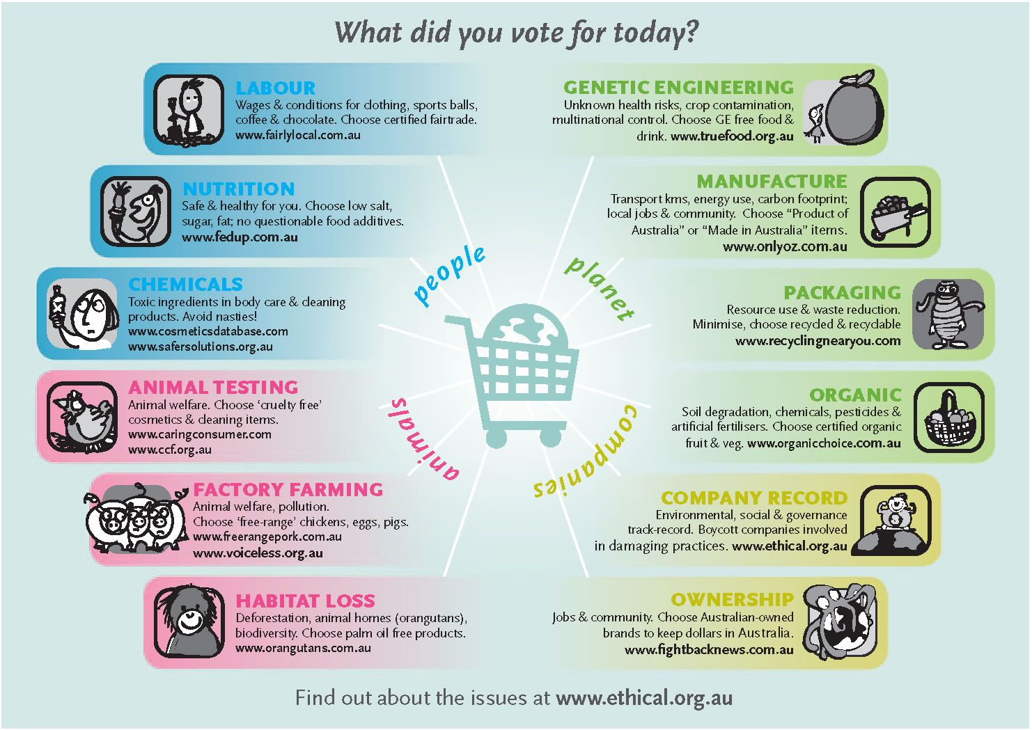
Constraints to enacting consumer concerns

Slide 11
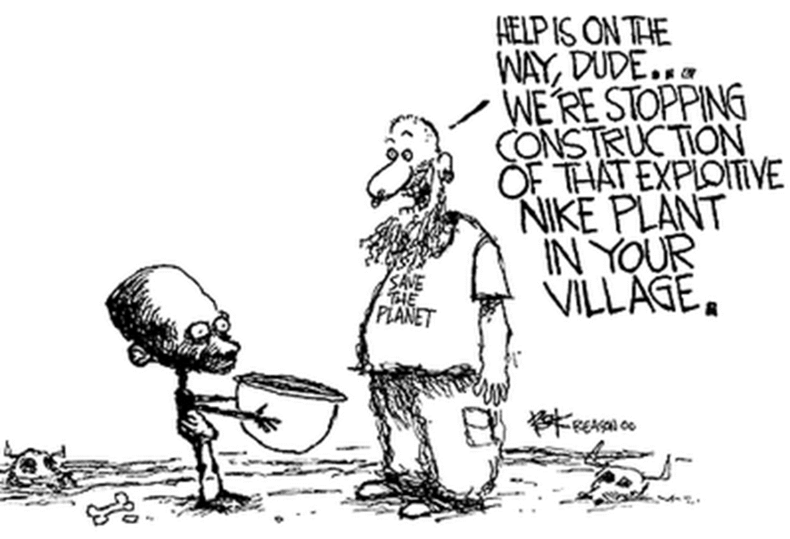

Slide 12
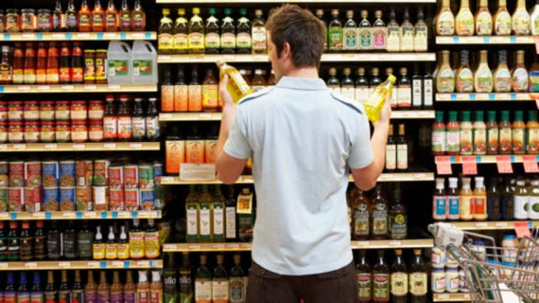
Approaches to Study
Rational Consumer
  Rational choice = maximise the expected benefits from our actions

Slide 13
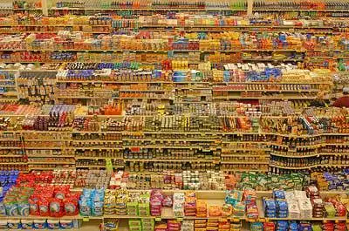
Approaches to Study
Bounded Rationality
  In decision-making face uncertainty about costs of acquiring information in present and future.
  Environmental problems are uncertain.
  Acts of others are uncertain.
Bounded Rationality = satisficing
Simon, 1957; Newholm, 2015

Slide 14
Care in Ethical Consumption
Title –
  ‘Do ethical consumers care about price?’ (Arnot et al., 2006)
  ‘Do consumers really care about corporate responsibility?’ (Boulstridge & Carrigan, 2000)
  ‘Do Consumers care about ethical-luxury?’ (Davies et al., 2012)
  ‘Do consumers care about ethics?’ (De Pelsmacker et al., 2005)
  ‘Caring at a distance’ (Greenfield & Williams, 2011)
  ‘Why don’t consumers care about CSR?’ (Öberseder et al., 2011)

Slide 15
Figure 2. Care in Consumption Revisited
Challenges
Care Awareness
benevolence
beneficence
respect
Care
Action
Family
Community
Environment
Producers
Retailers
NGOs
Self
care
care
trust
personalization
hope
authorization
Care Responsibility
Challenges
Shaw, Newholm, Longo & Toulouse, 2017

Slide 16
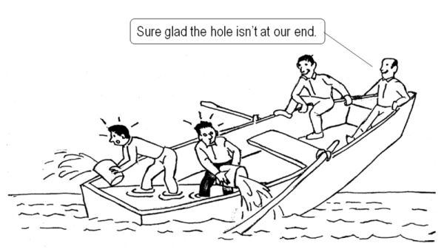
Neutralisation

Slide 17
Neutralisation
Neutralization Technique | Meaning
Denial of responsibility | Reneging on personal accountability citing external factors.
Denial of injury | No party in the exchange was adversely affected
Denial of victim | A sense of personal justice prevails whereby the violated party ‘deserved it’.
Condemning the condemners | Those who would condemn are likely to engage in similar activities.
Appeal to higher loyalties | Citing the actualization of higher order ideals or values.

Slide 18
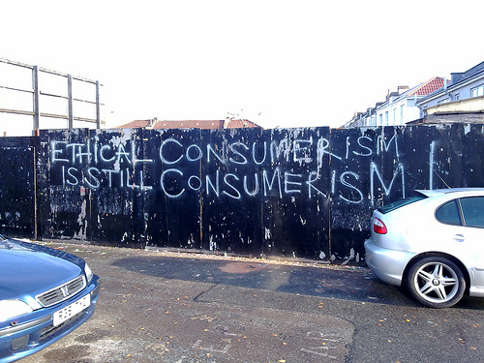
Shopping for change

Slide 19
Definition: Boycott
‘…an attempt by one or more parties to achieve certain objectives by urging individual consumers to refrain from making selected purchases in the marketplace’. (Friedman, 1999).
‘…conspicuous acts of anticonsumption’.
(Kozinets and Handelman, 1998)

Slide 20


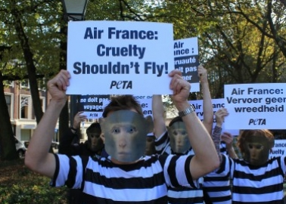
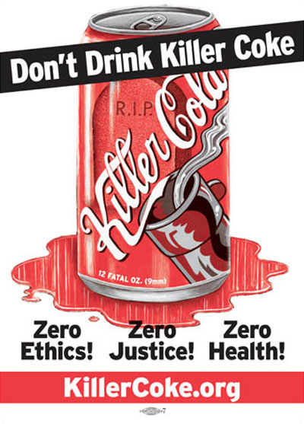

Current Boycotts
https://www.ethicalconsumer.org/ethicalcampaigns/boycotts

Slide 21

Definition: Buycott
The opposite of a boycott. Deliberately purchasing a company's or a country's products in support of their policies, or to counter a boycott.

Slide 22
Consumption as Voting
“Money makes the world go round, and deciding how we spend our money might just save it…Buying cheap clothes which have been made in sweatshops is a vote for worker exploitation. Buying a gas guzzling 4X4, especially if you are a city dweller, is a vote for climate change”.
(http://www.ethicalconsumer.org/aboutec/whybuyethically.htm)

Slide 23
Consumer Sovereignty
…is a market situation where consumers have the power to ultimately decide which products and services society will produce and consume…”the consumer is king”. When consumer sovereignty exists production in the economy is directed by millions of consumers making buying decisions with their dollar votes. Garman (1997: 5)

Slide 24
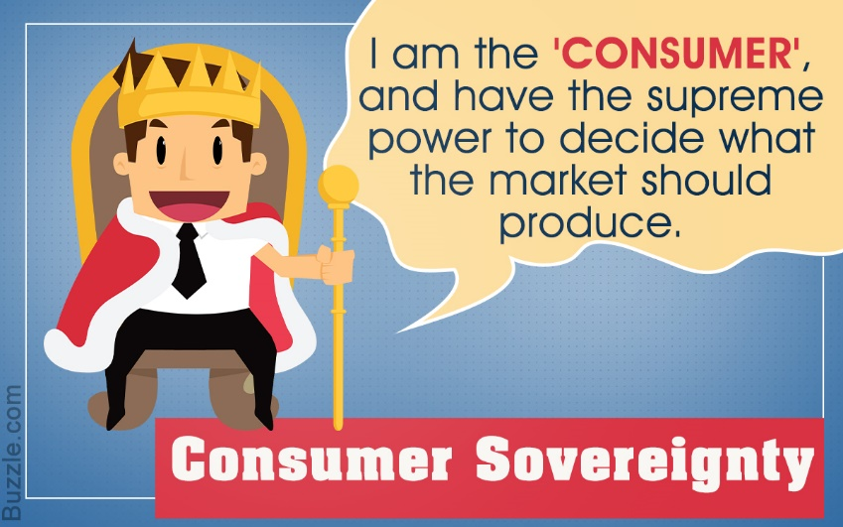
Sovereignty?
Are you sovereign as an ethical consumer?
Consider differing consumption decisions to illustrate your argument.
Considering your purchases as votes what signals (positive and negative) are these consumption decisions sending to producers?
Does ‘voting’ in the market system communicate consumers’ concerns to producers and retailers well?

Slide 25
Consumer Sovereignty
In short, consumers are not sovereign but one can refer to a degree of sovereignty, enhanced by choice, information, and possibly (though not necessarily in all cases) retailer assessment; but restricted by limitations of competition, actions by the state, and individual wealth.
Smith (1990: 35)

Slide 26

Challenges to Consumer Sovereignty
Choice
Information
Wealth
Differing sovereignty
Conflicting and uncertain votes

Slide 27
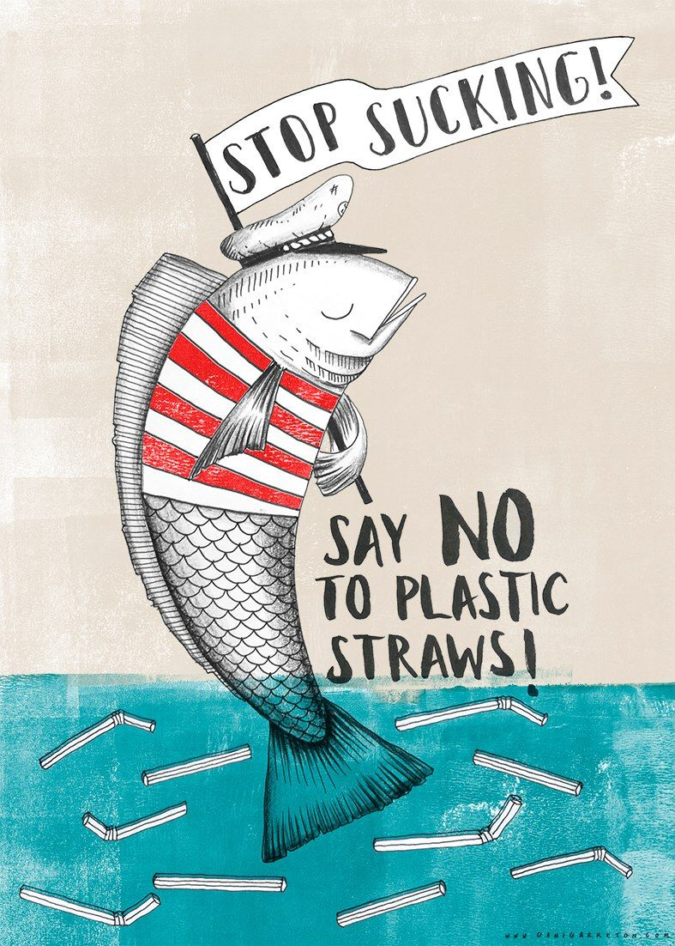
Enhancing Consumer Sovereignty
Care
Low cost of participation
Easy to understand
Mass media support
Diermeier, 2012

Slide 28
References
Arnot, C., Boxall, P. C. and Cash, S. B. (2006) Do Ethical Consumers Care About Price? A Revealed Preference Analysis of Fair Trade Coffee Purchases, Canadian Journal of Agricultural Economics, 54, 555–565.
Ajzen, I., 1991, The Theory of Planned Behavior. Organizational Behavior and Human Decision Processes, 50, 179-211.
Boulstridge, E. and Carrigan, M. (2000) Do consumers really care about corporate responsibility? Highlighting the attitude-behaviour gap, Journal of Communication Management, 4 (4), 355-368.
Chatzidakis, A., Hibbert, S. & Smith, A. (2007) Why people don’t take their concerns about fair trade to the supermarket: The role of neutralization, Journal of Business Ethics, 74, 89-100.
Creyer, E. H. and Ross, W T Jr (1997) The influence of firm behavior on purchase intention: do consumers really care about business ethics?, Journal of Consumer Marketing, 14 (6), 421-432.
Davies, I. A., Lee, Z. And Ahonhhan, I. (2012) Do Consumers Care About Ethical-Luxury?, Journal of Business Ethics, 106, 37-51.
De Pelsmacker, P., Driesen, L. and Rayp, G. (2005) Do Consumers Care about Ethics? Willingness to Pay for Fair-Trade Coffee: ‘Do consumers care about ethics?’, Journal of Consumer Affairs, 39 (2), 363-385.
Dickinson, R. and Carsky, M. 2005. The Consumer as Voter: An Economic Perspective on Ethical Consumer Behavior. In Harrison, R., Newholm, T. and Shaw, D. (Eds.). The Ethical Consumer. London: Sage.
Friedman, M. (1999), Consumer Boycotts: Effecting Change Through the Marketplace and the Media, Routledge, London.
Garman, E. T. (1997) Consumer Economic Issues in America, Dame: Houston.

Slide 29
References
Hassan, L., Shiu, E. & Shaw, D. (2016) ‘A Review and Empirical Case Study of the Intention-Behaviour Gap in Ethical Consumption: Exploring the Contribution of the Theories of Reasoned Action and Planned Behaviour’. Journal of Business Ethics. 136: 219-236.
Kozinets, R. V. and Handelman, J. M. (1998) “Ensouling Consumption: A Netnographic Exploration of Boycotting Behavior” Advances in Consumer Research Vol 25, 475-480.
Micheletti, M. (2003) Political Virtue and Shopping: Individuals, Consumerism and Collective Action, Palgrave: New York
Micheletti, M., Dietland, S. & Nishikawa, L. The Case of Discursive Political Consumerism: The Nike E-mail Exchange.
Micheletti, M., Follesdal, A. and Stolle, D. (2004) Politics, Products and Markets, Transaction.
Newholm, T. (2005). Case studying ethical consumers’ projects and strategies. The ethical consumer, 107-124.
Prestin, A. and Pearce, K. E. (2010) We care a lot: Formative research for a social marketing campaign to promote school-based recycling, Resources, Conservation and Recycling, 54, 1017-1026.
Öberseder, M., Schlegelmilch, B. B. And Gruber, V. (2011) “Why Don’t Consumers Care About CSR?’’: A Qualitative Study Exploring the Role of CSR in Consumption Decisions, Journal of Business Ethics, 104, 449-460.
Shaw, D., Newholm, T. and Dickinson, R. (2006) “Consumption as Voting: An Exploration of Consumer Empowerment”. European Journal of Marketing, 40 (9/10), 1049-1067.

Slide 30
References
Shaw, D. and Black, I. (2010) “Market Based Political Action: A Path to Sustainable Development”. Sustainable Development, 18 (6), 385-397.
Shaw, D., McMaster, R. and Newholm, T. (2016) Care and commitment in ethical consumption: an exploration of the ‘attitude–behaviour gap'. Journal of Business Ethics, 136(2), pp. 251-265.
Shaw, D., McMaster, R., Longo, C. and Özçaglar-Toulouse, N. (2017) Ethical qualities in consumption: Towards a theory of care. Marketing Theory, 17(4), pp. 415-433.
Shaw, D., and Newholm, T. (2002)Voluntary simplicity and the ethics of consumption. Psychology and Marketing, 19 (2). pp. 167-185.
Simon, F. L. (1995) Global corporate philanthropy: a strategic framework, International Marketing Review, 12 (4), 20-37.
Simon, Herbert (1957). "A Behavioral Model of Rational Choice", in Models of Man, Social and Rational: Mathematical Essays on Rational Human Behavior in a Social Setting. New York: Wiley. (for example)
Smith, C. (1990) Morality and the Market, Routledge: London.

Slide 31

Please bring any questions about this Unit to the weekly surgery session.

